Slide 1
BusyBox

Slide 2
What is BusyBox ?
A Linux system needs a basic set of programs to work
An init program
A shell
Various basic utilities for file manipulation and system configuration
In normal GNU/Linux systems, these programs are provided by different projects
coreutils, bash, grep, sed, tar, wget, modutils, etc. are all different projects
A lot of different components to integrate
Components not designed with embedded systems constraints in mind: they are not very configurable and have a wide range of features
BusyBox is an alternative solution, extremely common on embedded systems

Slide 3

General purpose toolbox: BusyBox
https://www.busybox.net/
Rewrite of many useful UNIX command line utilities
Created in 1995 to implement a rescue and installer system for Debian, fitting in a single floppy disk (1.44 MB)
Integrated into a single project, which makes it easy to work with
Designed with embedded systems in mind: highly
configurable, no unnecessary features
Called the Swiss Army Knife of Embedded Linux
License: GNU GPLv2
Alternative: Toybox, BSD licensed (https://en.wikipedia.org/wiki/Toybox)

Slide 4
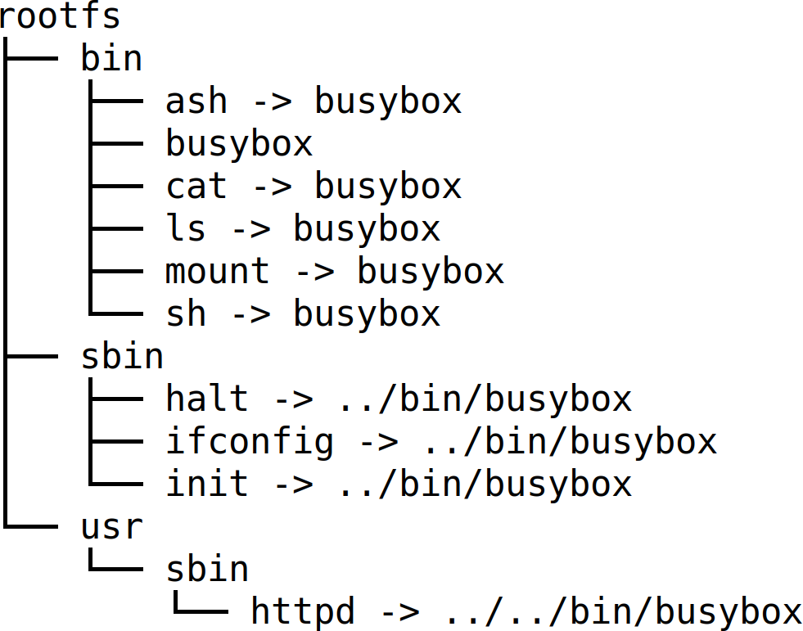
BusyBox in the root filesystem
All the utilities are compiled into a single executable, /bin/busybox
Symbolic links to /bin/busybox are created for each application integrated into BusyBox
For a fairly featureful configuration, less than 500 KB (statically compiled with uClibc) or less than 1 MB (statically compiled with glibc).

Slide 5
BusyBox - Most commands in one binary
[, [[, acpid, add-shell, addgroup, adduser, adjtimex, arch, arp, arping, ash, awk, base64, basename, bc, beep, blkdiscard, blkid, blockdev, bootchartd, brctl, bunzip2, bzcat, bzip2, cal, cat, chat, chattr, chgrp, chmod, chown, chpasswd, chpst, chroot, chrt, chvt, cksum, clear, cmp, comm, conspy, cp, cpio, crond, crontab, cryptpw, cttyhack, cut, date, dc, dd, deallocvt, delgroup, deluser, depmod, devmem, df, dhcprelay, diff, dirname, dmesg, dnsd, dnsdomainname, dos2unix, dpkg, dpkg-deb, du, dumpkmap, dumpleases, echo, ed, egrep, eject, env, envdir, envuidgid, ether-wake, expand, expr, factor, fakeidentd, fallocate, false, fatattr, fbset, fbsplash, fdflush, fdformat, fdisk, fgconsole, fgrep, find, findfs, flock, fold, free, freeramdisk, fsck, fsck.minix, fsfreeze, fstrim, fsync, ftpd, ftpget, ftpput, fuser, getopt, getty, grep, groups, gunzip, gzip, halt, hd, hdparm, head, hexdump, hexedit, hostid, hostname, httpd, hush, hwclock, i2cdetect, i2cdump, i2cget, i2cset, i2ctransfer, id, ifconfig, ifdown, ifenslave, ifplugd, ifup, inetd, init, insmod, install, ionice, iostat, ip, ipaddr, ipcalc, ipcrm, ipcs, iplink, ipneigh, iproute, iprule, iptunnel, kbd_mode, kill, killall, killall5, klogd, last, less, link, linux32, linux64, linuxrc, ln, loadfont, loadkmap, logger, login, logname, logread, losetup, lpd, lpq, lpr, ls, lsattr, lsmod, lsof, lspci, lsscsi, lsusb, lzcat, lzma, lzop, makedevs, makemime, man, md5sum, mdev, mesg, microcom, mim, mkdir, mkdosfs, mke2fs, mkfifo, mkfs.ext2, mkfs.minix, mkfs.vfat, mknod, mkpasswd, mkswap, mktemp, modinfo, modprobe, more, mount, mountpoint, mpstat, mt, mv, nameif, nanddump, nandwrite,
nbd-client, nc, netstat, nice, nl, nmeter, nohup, nologin, nproc, nsenter, nslookup, ntpd, nuke, od, openvt, partprobe, passwd,
paste, patch, pgrep, pidof, ping, ping6, pipe_progress, pivot_root, pkill, pmap, popmaildir, poweroff, powertop, printenv, printf, ps, pscan, pstree, pwd, pwdx, raidautorun, rdate, rdev, readahead, readlink, readprofile, realpath, reboot, reformime,
remove-shell, renice, reset, resize, resume, rev, rm, rmdir, rmmod, route, rpm, rpm2cpio, rtcwake, run-init, run-parts, runlevel,
runsv, runsvdir, rx, script, scriptreplay, sed, sendmail, seq, setarch, setconsole, setfattr, setfont, setkeycodes, setlogcons, setpriv, setserial, setsid, setuidgid, sh, sha1sum, sha256sum, sha3sum, sha512sum, showkey, shred, shuf, slattach, sleep, smemcap, softlimit, sort, split, ssl_client, start-stop-daemon, stat, strings, stty, su, sulogin, sum, sv, svc, svlogd, svok, swapoff, swapon, switch_root, sync, sysctl, syslogd, tac, tail, tar, taskset, tc, tcpsvd, tee, telnet, telnetd, test, tftp, tftpd, time, timeout, top, touch, tr, traceroute, traceroute6, true, truncate, ts, tty, ttysize, tunctl, ubiattach, ubidetach, ubimkvol, ubirename, ubirmvol, ubirsvol, ubiupdatevol, udhcpc, udhcpc6, udhcpd, udpsvd, uevent, umount, uname, unexpand, uniq, unix2dos, unlink, unlzma, unshare, unxz, unzip, uptime, users, usleep, uudecode, uuencode, vconfig, vi, vlock, volname, w, wall, watch, watchdog, wc, wget, which, who, whoami, whois, xargs, xxd, xz, xzcat, yes, zcat, zcip
Source: run /bin/busybox - July 2021 status

Slide 6
Configuring BusyBox
Get the latest stable sources from https://busybox.net
Configure BusyBox (creates a .config file):
make defconfig
Good to begin with BusyBox.
Configures BusyBox with all options for regular users.
make allnoconfig
Unselects all options. Good to configure only what you need.
make menuconfig (text)
Same configuration interfaces as the ones used by the Linux kernel (though older versions are used, causing make xconfig to be broken in recent distros).

Slide 7
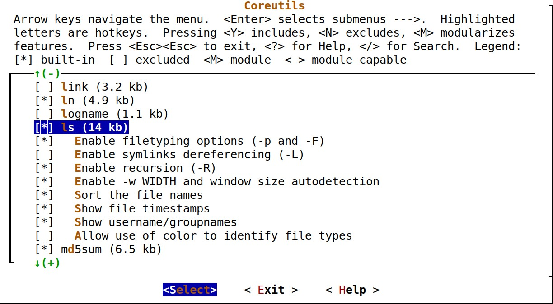
BusyBox make menuconfig
You can choose:
the commands to compile,
and even the command options and features that you need!

Slide 8
Compiling BusyBox
Set the cross-compiler prefix in the configuration interface: Settings -> Build Options -> Cross Compiler prefix Example: arm-linux-
Set the installation directory in the configuration interface:
Settings -> Installation Options -> BusyBox installation prefix
Add the cross-compiler path to the PATH environment variable:
export PATH=$HOME/x-tools/arm-unknown-linux-uclibcgnueabi/bin:$PATH
Compile BusyBox:
make
Install it (this creates a UNIX directory structure with symbolic links to the
busybox executable):
make install

Slide 9
Applet highlight: BusyBox init
BusyBox provides an implementation of an init program
Simpler than the init implementation found on desktop/server systems (SysV init
or systemd)
A single configuration file: /etc/inittab
Each line has the form <id>::<action>:<process>
Allows to run services at startup, and to make sure that certain services are always running on the system
See examples/inittab in BusyBox for details on the configuration

Slide 10
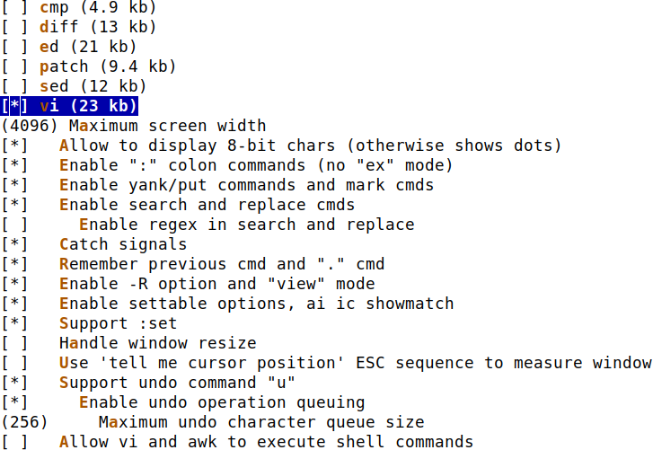
Applet highlight - BusyBox vi
If you are using BusyBox, adding vi support only adds about 20K
You can select which exact features to compile in.
Users hardly realize that they are using a lightweight vi version!
Tip: you can learn vi on the desktop, by running the vimtutor command.

Slide 11
Exercise (only for your own practice)
Make Linux boot on a directory on your workstation, shared by NFS
Create and configure a minimalistic Linux embedded system
Install and use BusyBox
System startup with /sbin/init
Set up a simple web interface
Use shared libraries

